Slide 1

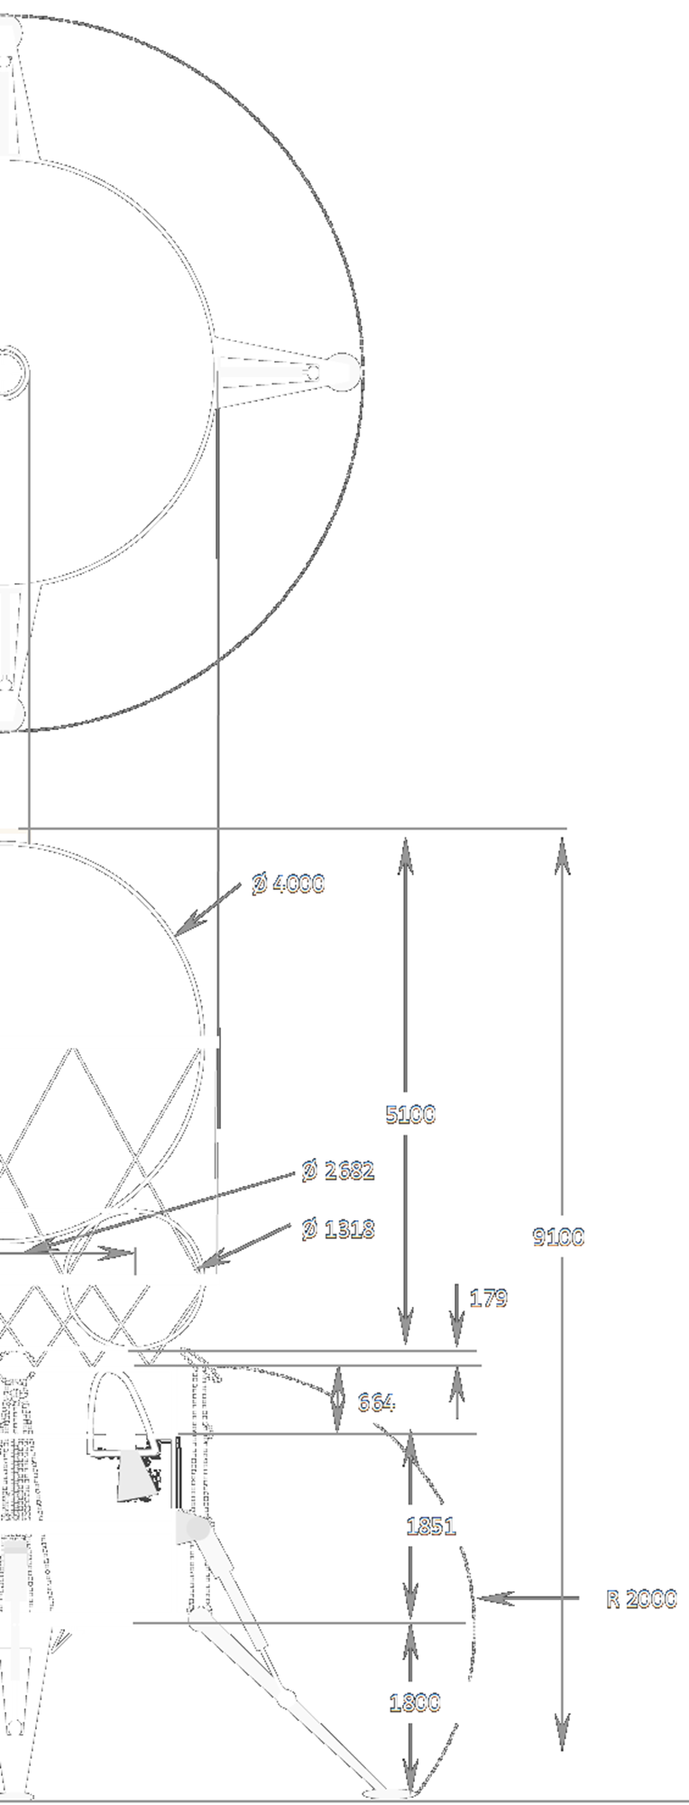
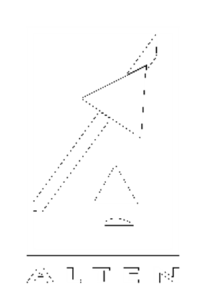

Moneyball
Finding Low-Cost Mission Architectures By Design Space Exploration Using Houbolt Questions
18/10/2024

Slide 2
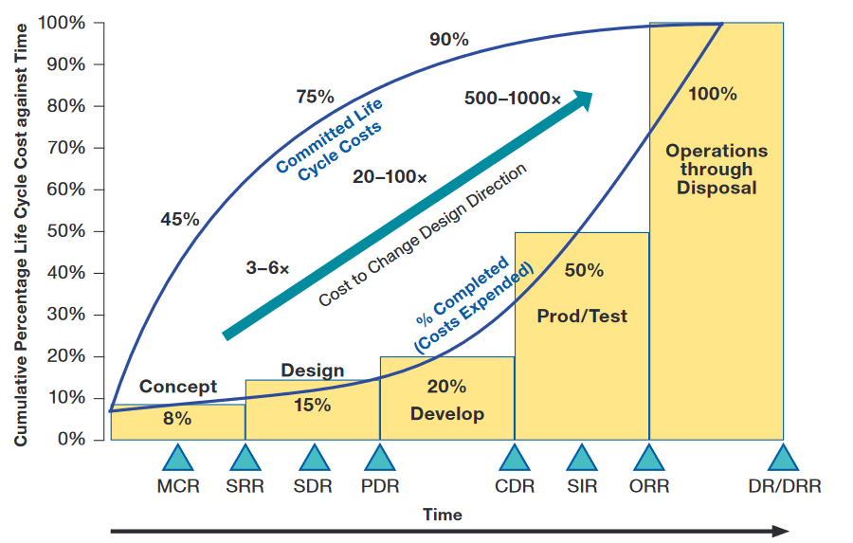
Space System Design
Phase A
Mission Statement
Stakeholder Analysis
Mission Objectives
Functional Analysis
Alt. Mission Architecures
Mission Architecture
Trade-off
Life-Cycle Cost Impacts from Early Phase Decision-Making [4]
System Requirements
2
Notes:
You may recognise this classic cost allocation and cost spending behaviour. Quite typical of space projects.
Early design decisions = big cost impact
Focus on design in Phase A

Slide 3
Research Question
What methods can mission designers use to systematically explore the design-space of space mission architectures in order to robustly identify the optimal pareto-set of low-cost architectures for their mission?
A. Design Space Modelling
B. Design Space Evaluation
                Houbolt Questions
Life Cycle Cost CERs and MERs
3

Slide 4
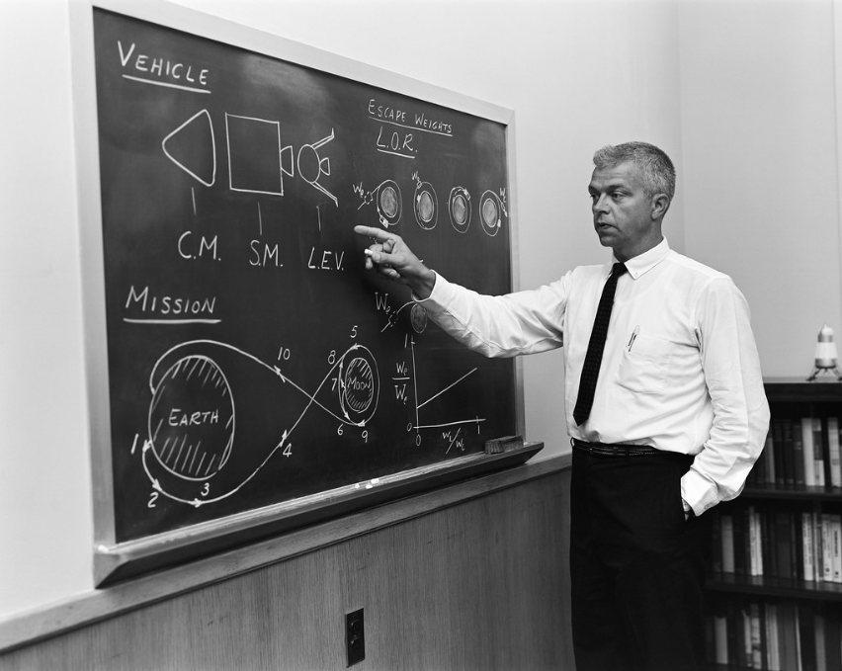
A. Houbolt Questions
Early design decisions with big performance impact
Direct Earth - Moon
OR
Lunar Orbit RDV
John Houbolt pushing the Lunar Orbit RDV idea (1962)
Inspiration for the following
4
Notes:
They are early design decisions with a big performance impact.
Houbolt Questions named after this guy who during the early Apollo program was responsible for the choice of Lunar Orbit Rendez-vous
The term Houbolt Question appears sometimes in the literature,
but has never been elaborated or developed into a concept for modelling missions
Which is what I have decided to do.

Slide 5

A. Design Space Modelling
What and How?
constructor
Solution space
Solution space $⊂$Design space
5
Notes:
What space is set as the inThe constructor makes the solutions space from all of the combinations of the How questions
The solution space is a subset of the Design space
It should encompass as much of the Desgin space as possible, but it is limited.
So that’s how we model the design space, now lets see how to evaluate it.

Slide 6


B. Design Space Evaluation - Cost
$$L_{CC}= C_{ddte}+C_{p}+C_{o}+C_{d}$$
Cost Estimation
$$C_{ddte}=f_{a}(m, CPLX)$$
$$C_{p}=f_{b}\left(m, CPLX\right)$$
$$C_{o}=f_{c}\left(m, CPLX, t\right)$$
$$C_{d}=f_{d}(C_{o}, MKT)$$
Advanced Mission Cost Model
TruePlanning
6
Notes:
You can size the mass of the spacecraft using the delta V nd the payload mass which are available information in the Houbolt Quesitons

Slide 7
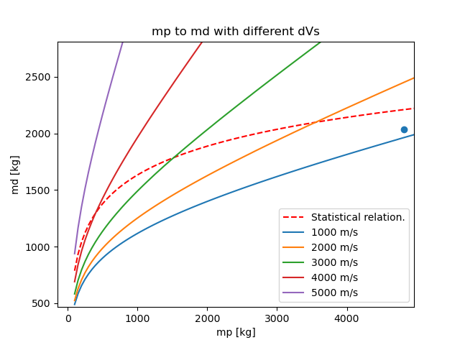
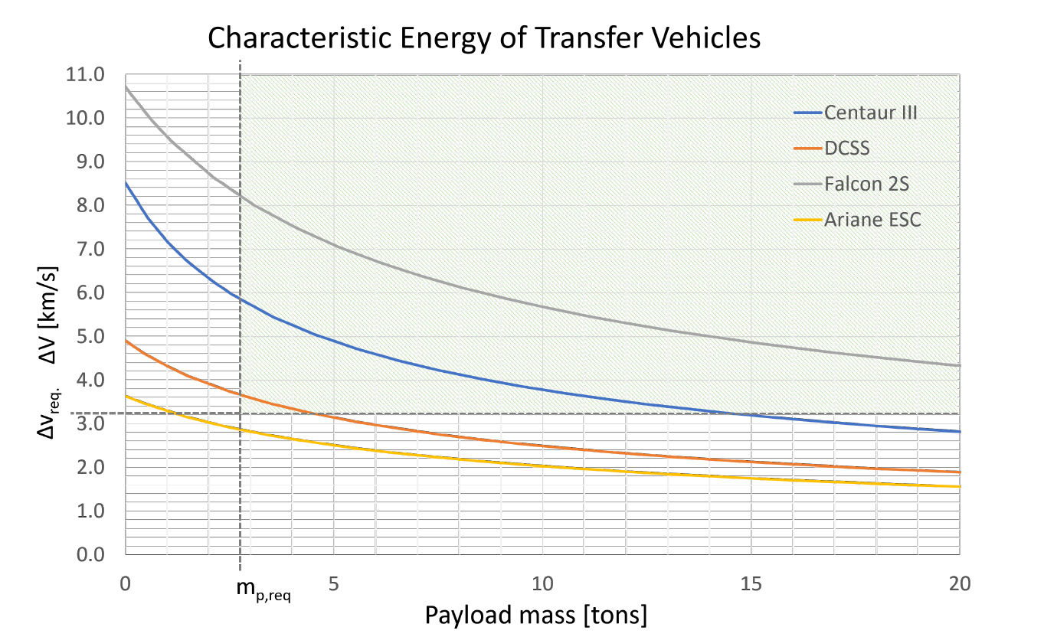
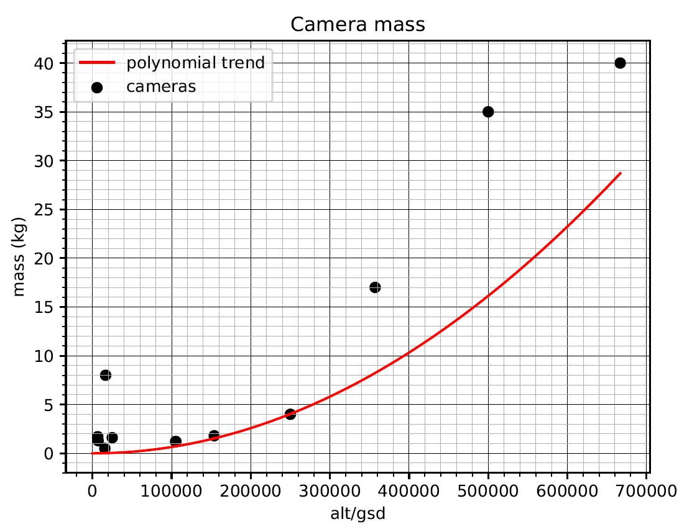
B. Design Space Evaluation - Cost
Mass Estimation Relationships
Lunar lander MERs [5]
Transfer vehicle MERs [5]
Orbiter MERs [6]
7
Notes:
You can size the mass of the spacecraft using the delta V nd the payload mass which are available information in the Houbolt Quesitons

Slide 8
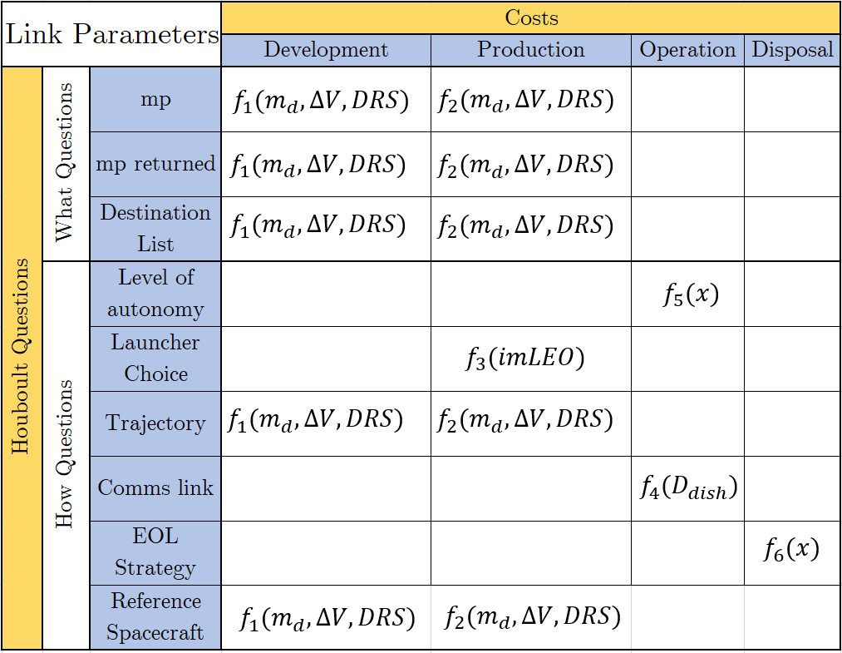




Modelling to Evaluation
Link functions connect Houbolt question to cost elements.
$f_{1}$ and $f_{2}$ are parametic sizing rules and specific CERs
$f_{3}$ is a launch cost function
$f_{4}$ is a CER based on ground station dish diameter → link-budget.
$f_{5},$ $f_{6}$, $f_{7},$ and $f_{8},$ are to come
$$f_{7}(x)$$
$$f_{6}(x)$$
$$f_{8}(x)$$
8

Slide 9
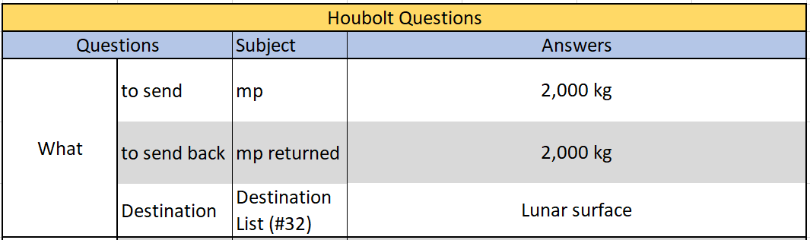
Case Study
Lunar cargo lander: Land and lift two tons of cargo to and from the lunar surface in a cost-effective manner.
constructor
Cost estimation
Mass estimation
Solution space
9
Notes:
Restricted

Slide 10
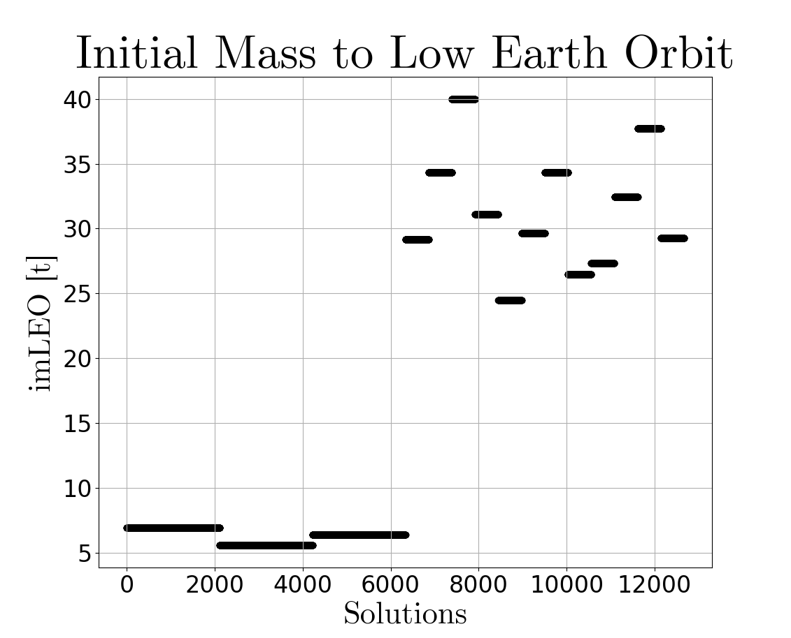
Results - mass
12,000 MAs
Two families: singles and double s/c Mas
Duplicaction due to HQ restriction
10
Notes:
Conclude here:
- Can use Houbolt questions to model the design space and there are MERs and CERs which can evaluate the design space.
- Will need to increase the scope of the questions to model more missions

Slide 11
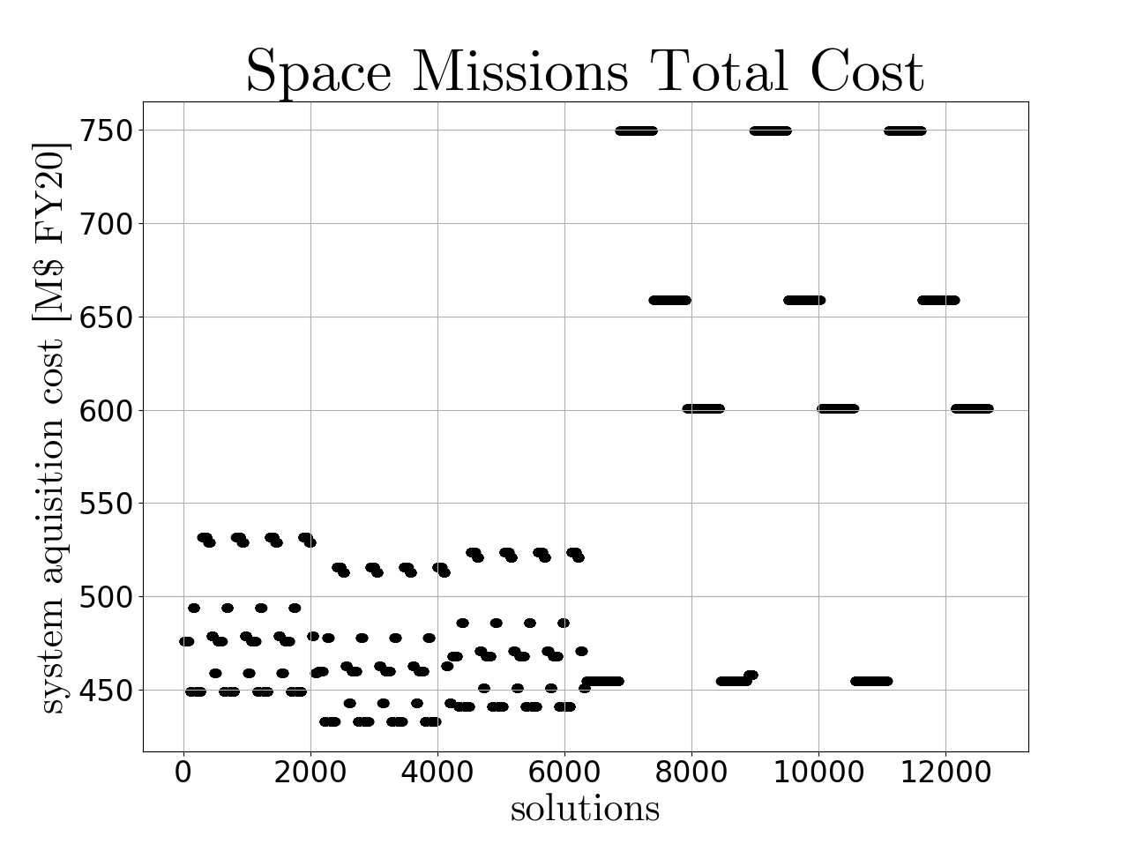
Results - Cost
Patterns due to cost domination by some decisions (e.g. The DRS choice).
The Lowest Cost MA
'Solution number ‘: #3425,
'Lander Fuel ': 'LOX/LH2',
'Lander dry mass ': 1533.45 kg,
'imLEO ': 5558 kg,
'md_mission ': 1533 kg,
'launcher ': 'Falcon 9',
'Acq_cost ‘: €432M
11
Notes:
Conclude here:
- Can use Houbolt questions to model the design space and there are MERs and CERs which can evaluate the design space.
- Will need to increase the scope of the questions to model more missions

Slide 12
Conclusions
Design Space Modelling
Design Space Evaluation
The Long Term Goal
                Houbolt Questions are an interesting method
                Repetition shows need for expansion
Link functions can evaluate cost from HQs
Add cost uncertainty
Compete link functions
To have a method of reliably finding the cheapest mission architecture for the given mission statement.
To propose some new, interesting, and cheap mission architectures.
13

Slide 13
6. References
[1] http://news.bbc.co.uk/2/hi/science/nature/8442090.stm
[2] https://goldprice.org/
[3] https://ourworldindata.org/grapher/cost-space-launches-low-earth-orbit?time=2001..latest
[4] S. J. Kapurch, NASA Systems EngineeringHandbook, S. J. Kapurch, Ed. Diane Publish-ing, 2010.
[5] C. de Paor, J. Rimani, and S. Lizy-Destrez,“Low-Cost Uncrewed Lunar Landers: Mis-sion Design and Preliminary Feasibility As-sessment”, Jul. 2023. DOI: 10 . 13009 /EUCASS2023-958.
[6] C. de Paor and T. Gateau, “System design, sizing and costing of a respon-sive space system”, Alten, Internship Report,Oct. 2023

Slide 14
Thank you!
Questions

Slide 15
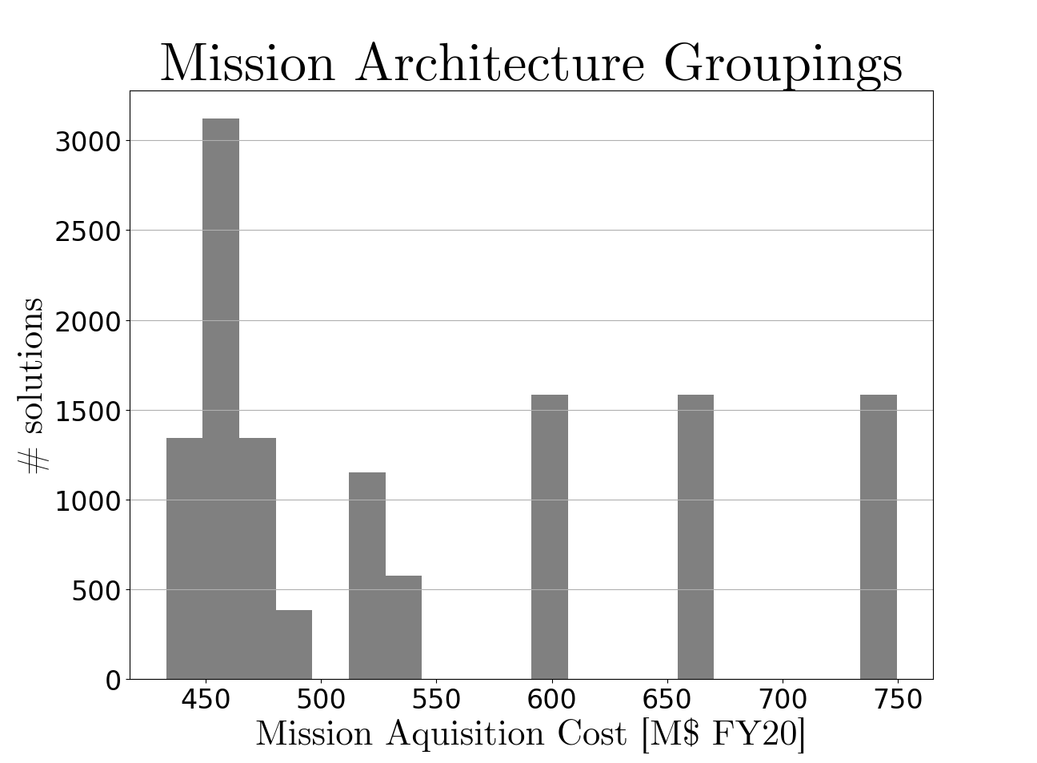
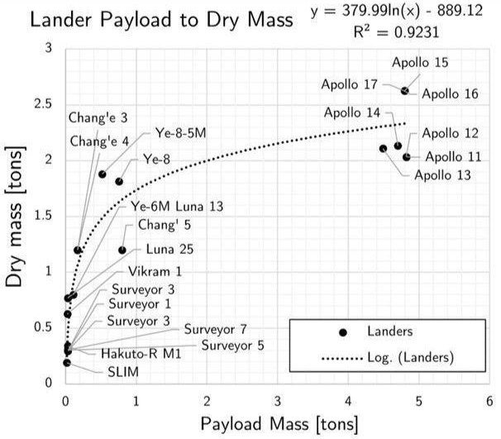
Appendix
12
Notes:
Conclude here:
- Can use Houbolt questions to model the design space and there are MERs and CERs which can evaluate the design space.
- Will need to increase the scope of the questions to model more missions

